Slide 1

INSIDER CYBER SECURITY THREATS TO ORGANIZATION
Safiullah Rehmani 12413
Raameez hussain 8290
Submitted to Dr.Maaz Bin ahmed

Slide 2
THREATS:
A threat is potential negative action or even occur due to flaws In
computer system that weaken the overall security ether hardware
and software and this allow threat actor to cross boundaries and
perform unauthorized activities within computer system. Result
unwanted impact to system or application.

Slide 3
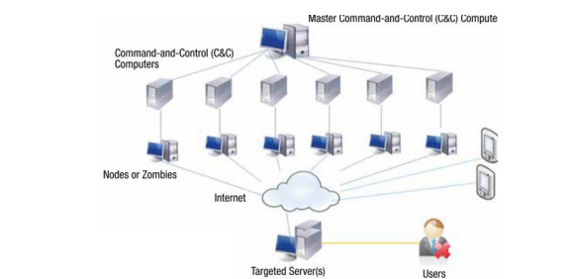
THREAT MODE IN NETWORK DEVICES
Network security starts with authenticating any user, probably as a username and password. After verifying a firewall enforces access policies, such as which services users can access. Although effective to prevent unauthorized access, this component may fail to scan for potentially harmful content such as computer worms or Network-borne Trojan horses. Anti-virus software or an intrusion prevention system (IPS) helps detect it. and prevent such malware from operating.
Distributed Attack
Insider attack

Slide 4
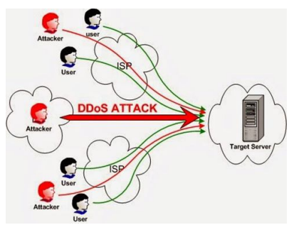
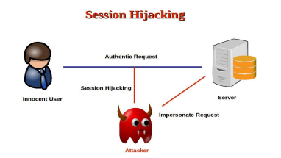
.
Denial of Service Attack
Hijack Attack

Slide 5
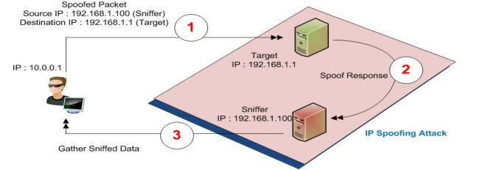
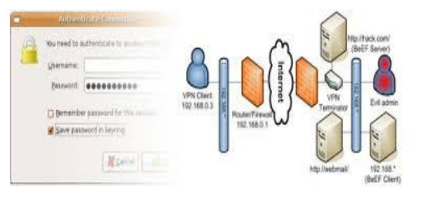
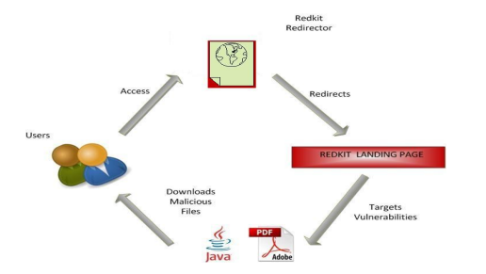
.
Spoof Attack
Password Attack
Exploit attack
Buffer overflow

Slide 6
Threat actors for isolated devices
A threat actor, also known as a malicious actor, is any person or organization that intentionally causes harm in the digital realm. They exploit weaknesses in computers, networks, and systems to conduct disruptive attacks on individuals or organizations.
Man in middle
A man-in-the-middle attack is a type of eavesdropping attack where attackers interrupt an existing conversation or data transfer. After inserting themselves into the "middle" of the transfer, attackers impersonate both legitimate participants. This allows an attacker to capture information and data from either party while sending malicious links or other information to both legitimate participants in a way that may not be detected until it is too late.

Slide 7
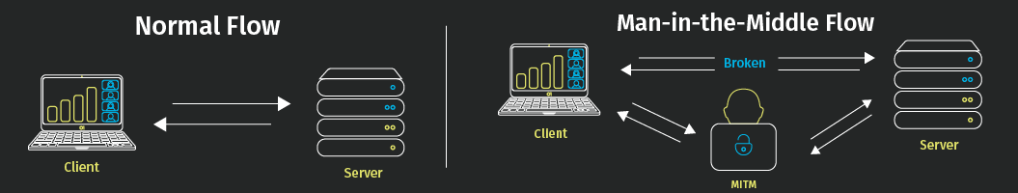
Examples of MITM Attacks Scenario 1: Intercepting Data

Slide 8
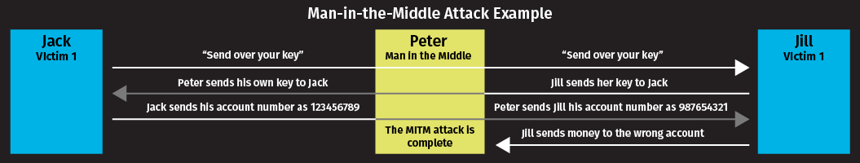
Examples of MITM Attacks Scenario 2: Gain Access to Resources

Slide 9
Adversary
An entity that is not authorized to access or modify information, or who works to defeat any protections afforded the information.
In its most simplistic definition, a cyber adversary is someone or a group that intends to perform malicious actions against other cyber resources. However, there is a lot of nuances in defining adversaries, which the simple definition doesn’t cover.

Slide 10
INSIDER CATEGORIES:
Insider:
an insider is any person from an organization who has an a authorized access to the resources of organization.
Insider Threats:
insider threats are threats that come from within an organization .It can be caused by a current or even former employee who has access to the network resources,devices and other sites that holds data.

Slide 11
1)Negligent insider:
Negligent insider are those who ignore any safety precautions when using
buseiness computers.
for example,an employee may have ignored any warnings about phishing emails
still choosing to open up without knowing what kind of trouble they are
going to cause.
2)Malicious insider:
Bad actors such as current or former employees,third parties or partners uses their
privileged access to steal intellectual property or company data for fraud ,revenge
0r blackmail.

Slide 12
3)Problematic insider:
some intentionally carry out malicious activities.
they can be anyone, from unhappy employees seeking revenge to
employees looking to make extra money by sharing confidential
information

Slide 13
Consequences of such threats:
There are a whole list of consequences your business can face :
ranging from data loss to a damaged reputation.
Attacks leads to a loss in reputation or finances.
Drop in sale due to loss of trust from customers to legal costs.

Slide 14
How can insider Threats be detected:
Here is the list of direct indicators in case of insider threats attacks:
Data Exfiltration.
Unauthorized use of external systems
Abnormal network activities such as crawling ,downloading of internal portals
Sharing data with outsiders

Slide 15
Indirect indicators in case of insider threats attacks:
Workspace access outside job hours.
Attempts to access priviliges areas
Complaints of unethical or hostile behaviours.
Violations of corporate policies.

